Slide 1
Nani's Puzzle House
Game Development Final Project
Department: SE-6B
Course instructor : Saima Sippy

Slide 2
Group Members
- Aliya Fasih (BSE-22F-127)
- Syeda Faiza Ali (BSE-22F-051)
- Talha Zaheer (BSE-22F-081)
- Ibrahim Shiekh(BSE-22F-089)

Slide 3
1. Introduction
"Nani’s Puzzle House" is a 3D puzzle game for players aged 7 and above. Set in an old house, players solve puzzles to escape using logic and exploration.

Slide 4
2. Storyline
The player is locked in their grandmother’s house and must find clues. A letter hints at a chocolate under the pillow, where they find a key that unlock the door needed to escape.

Slide 5
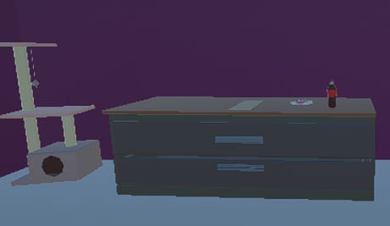
Game Overview

Slide 6
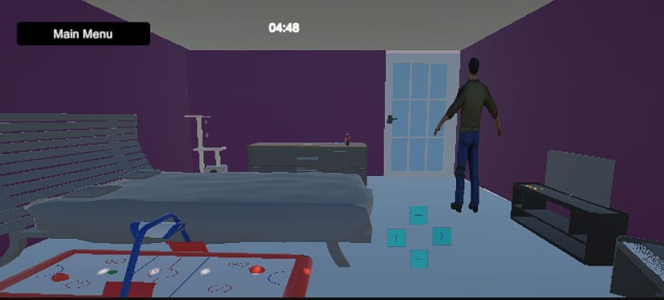

Slide 7


Slide 8
3. Gameplay Mechanics
- Movement with arrow keys
- Touch, tap, and drag interactions
- Puzzle steps:
1. Read letter
2. Find key under pillow
3. Get door key
4. Escape

Slide 9
4. Game Environment & Assets
3D room with:
- Bed
- TV
- Trolley
- Table
- Lamp
- Showpiece
- Piano
- Letter on Table

Slide 10
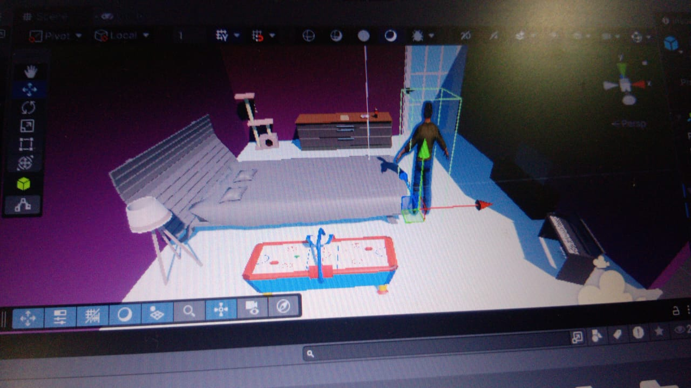
Room Design

Slide 11
5. Tools & Technologies
- Unity 3D (Game Engine)
- C# (Scripting)
- Unity Asset Store / Custom Assets

Slide 12
6. Challenges Faced
- Realistic object interactions
- Puzzle flow logic
- Clear and easy clues

Slide 13
7. Conclusion
Fun and challenging puzzle game in a nostalgic setting. Promotes logical reasoning. Future updates could include more rooms, sound effects, and multiple puzzles.

